Slide 1

Mortgage Default Prediction
Giulio Fabbri
Valentina Coppi

Slide 2
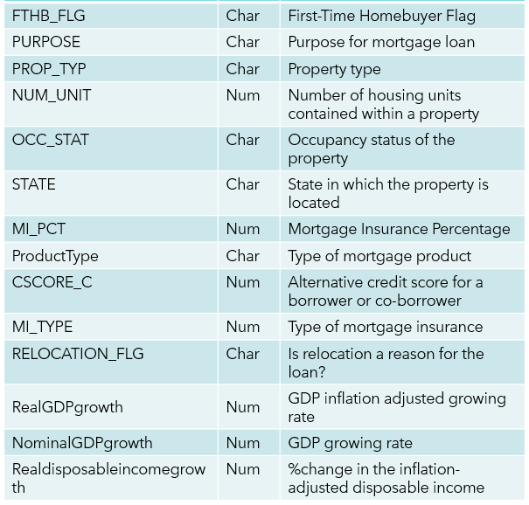
Our Dataset
Variable | Type | Description
LOAN_ID | Char | Unique identifier assigned to each loan
LoanAge | Num | Length of time since the loan was originated
LAST_UPB | Num | Last unpaid balance
willDefault | Char | Target binary variable ‘yes’ or ‘no’
ORIG_CHN | Char | Origination channel through which a loan was acquired
SellerName | Char | Entity that sold the loan
ORIG_RT | Num | Original interest rate associated with a loan
ORIG_AMT | Num | Original amortization term
ORIG_TRM | Num | Original term of the loan in months
OLTV | Num | Original Loan-to-Value ratio
OCLTV | Num | Original Combined Loan-to-Value ratio
NUM_BO | Num | Number of borrowers associated with a loan
DTI | Num | Debt-to-Income ratio
CSCORE_B | Num | Credit score associated with a borrower or a co-borrower

Slide 3
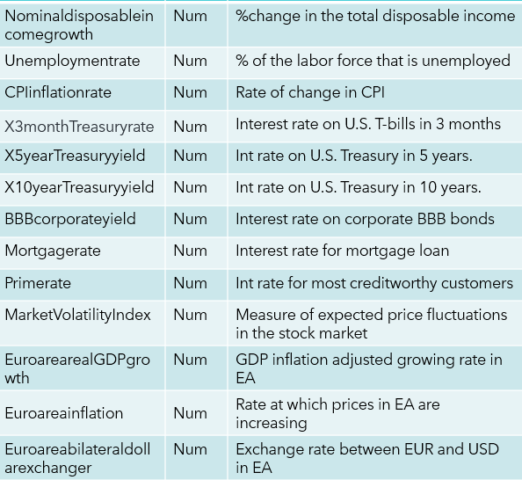
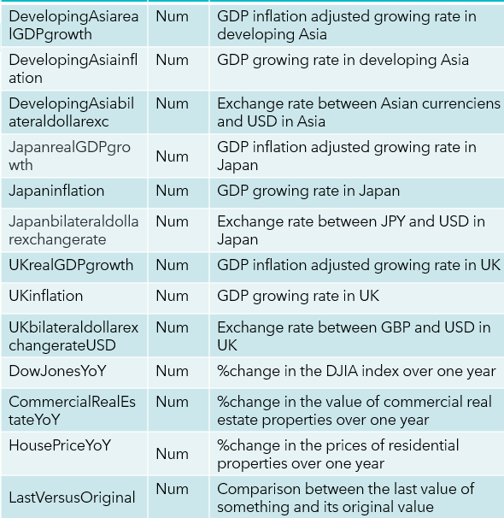
Our Dataset

Slide 4
SAS Studio

Slide 5
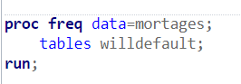
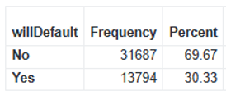
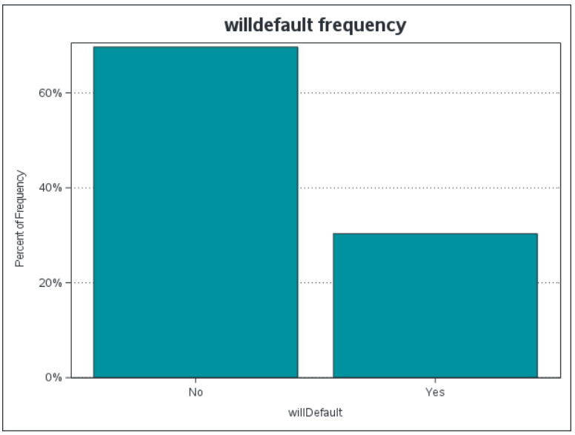
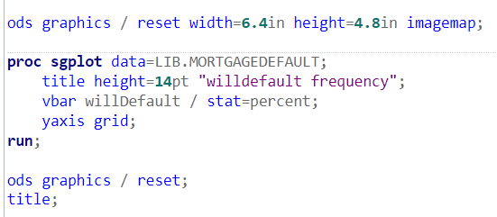
Divide the data
The dataset is unbalanced with respect to the target variable:
This is why we decided for a 50-50 event non-event sampling for rebalancing the dataset, in this way the models will not be biased in considering more not defaulted loans
In order to split the dataset we decided:
80% for the training partition
10% for the validation
10% for testing

Slide 6
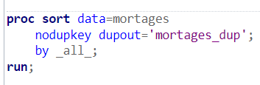
Duplicates & Missing Values
Check for the existence of double observations:
Throw this code we produced a table containing the double observations, but it is empty, so we can keep all the lines of our original table.
Check for the variables containing missing values:
Numerical Variables with missing values:
DTI, OCLTV, Cscore_B, Cscore_C, NUM_BO and especially MI_PCT and MI_type.
For MI_PCT we suppose that:
Na could stand for “No applied insurance on mortgage” (0 value)
if MI_PCT is missing, also MI_type is missing.
Nominal Variables have no missing values
Notes:
NODUPKEY removes duplicates
DUPOUT shows the duplicates
DTI = debt to income
OCLTV = (Original Combined Loan-to-Value) rapporto loan / collateral
NUM_BO = number of beneficiari del mutuo

Slide 7
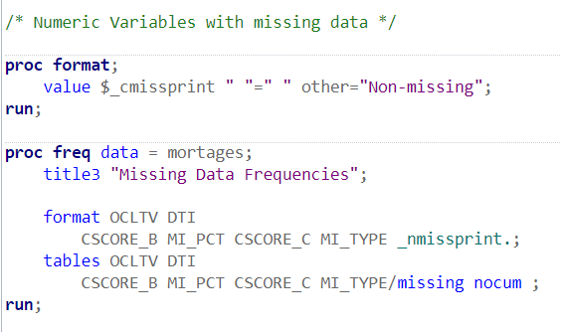
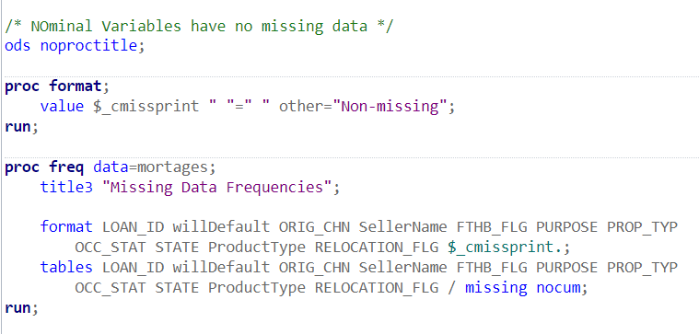
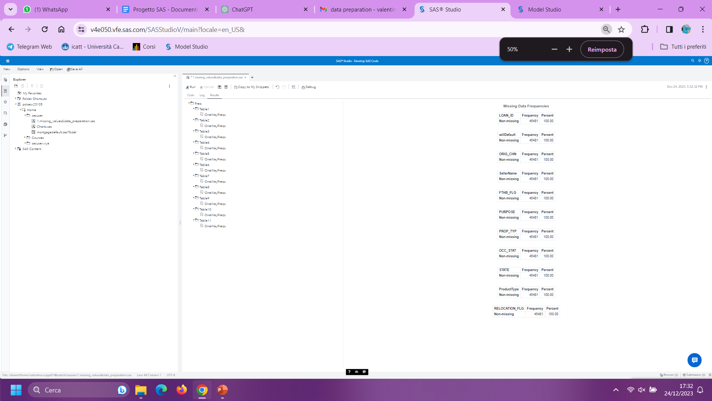
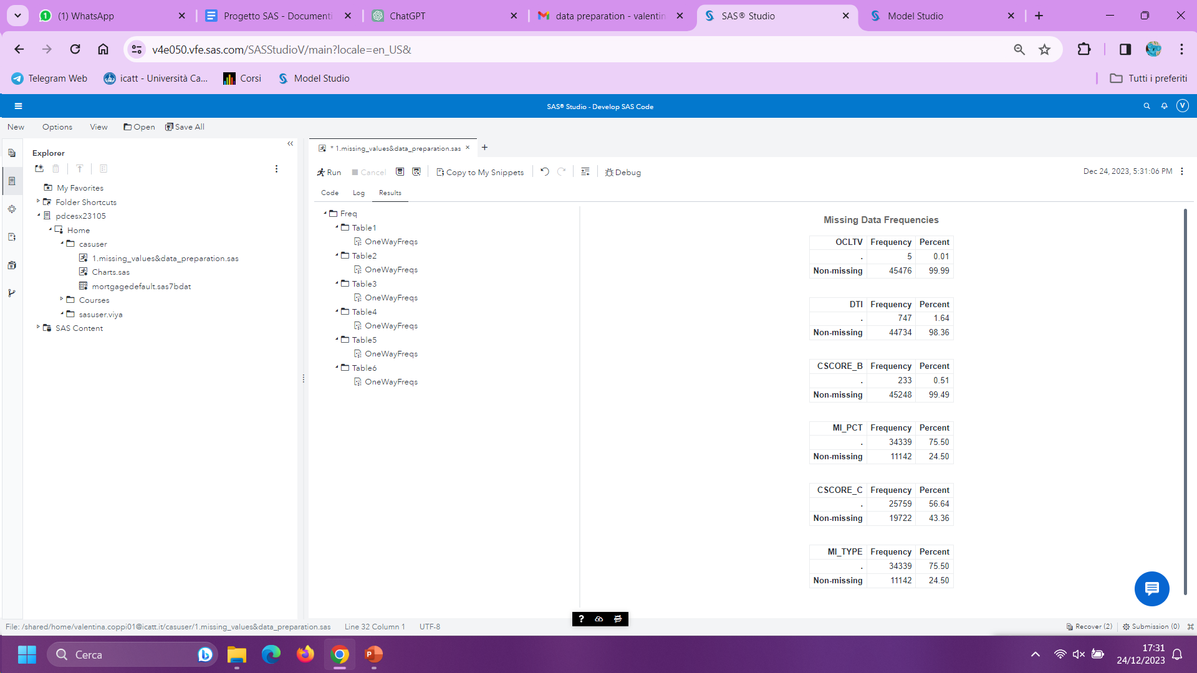
Notes:
PROC FORMAT for doing a new format of data
Value è count dei missing data se invece non c è un missing data scrive non missing

Slide 8
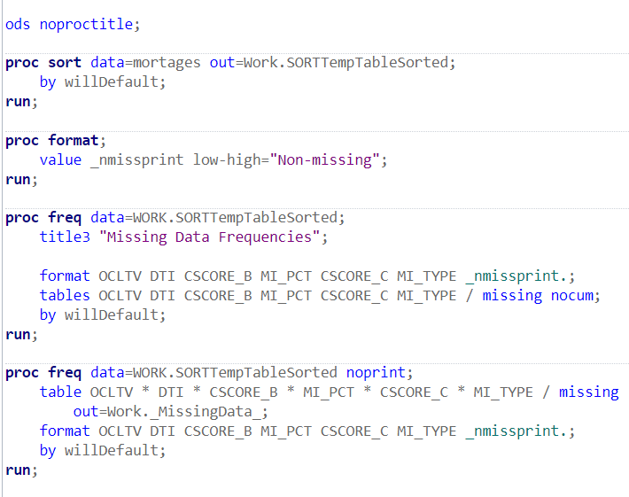
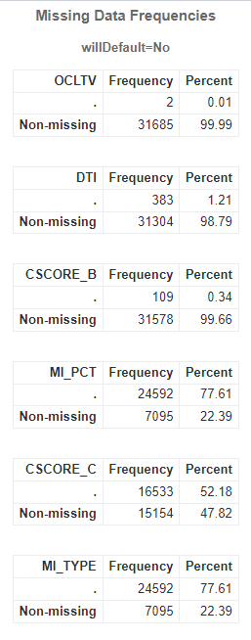
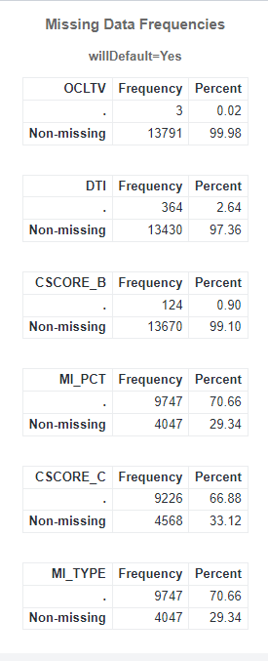
We checked also the NA distribution based on the target class:

Slide 9
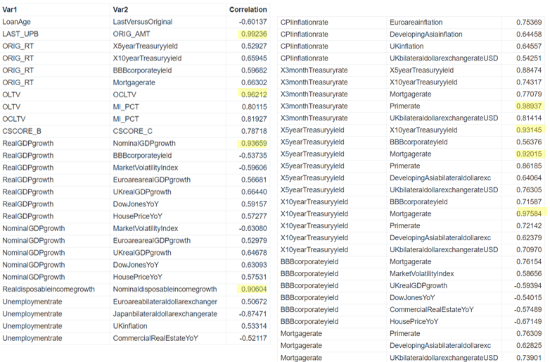
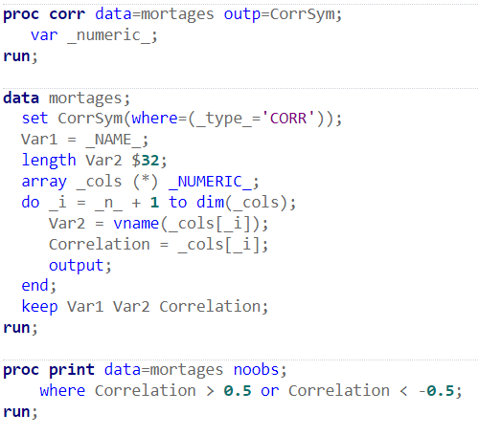
Variables Correlations
Some variables are highly correlated
Notes:
(*) multuply by

Slide 10
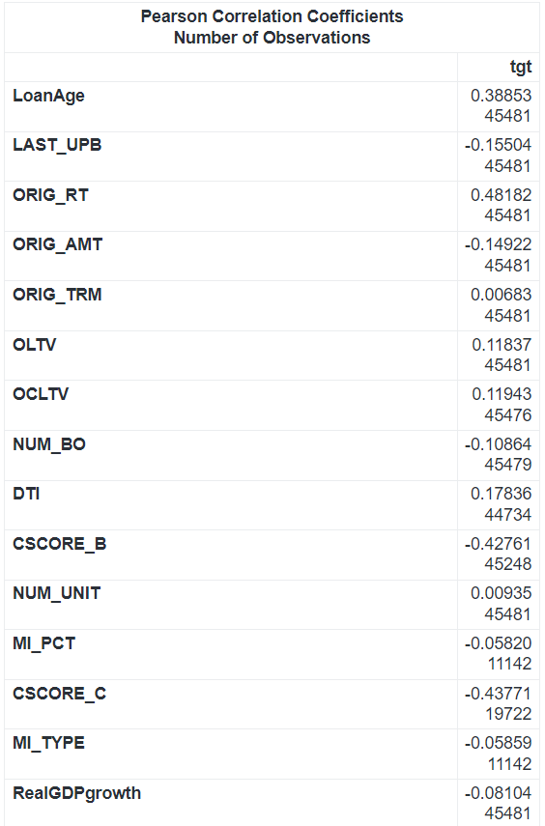
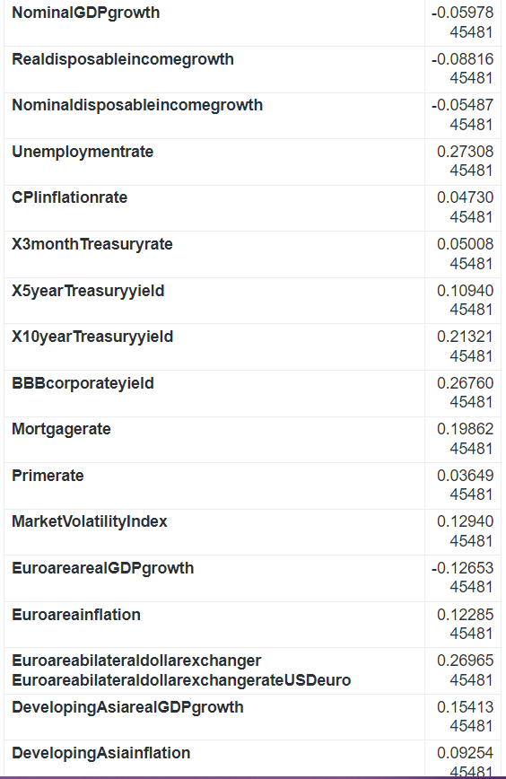
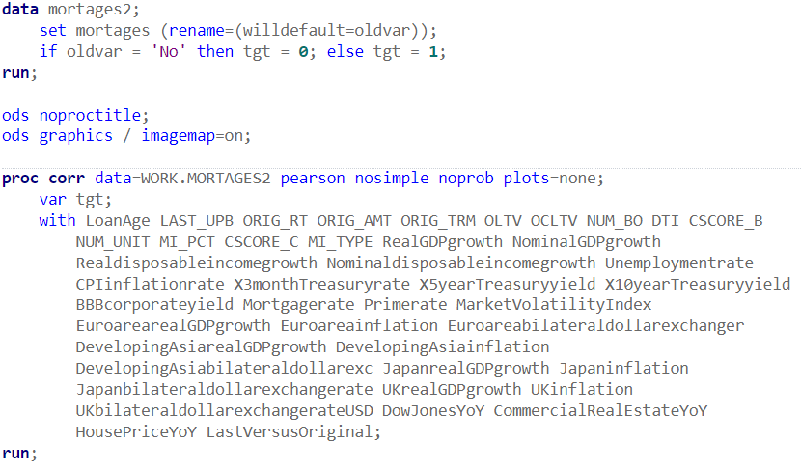
Target-Variables Correlations
Low Target-Variables
correlations
Notes:
Ods = output delivery system es graph
uppresses the writing of the title of the procedure

Slide 11
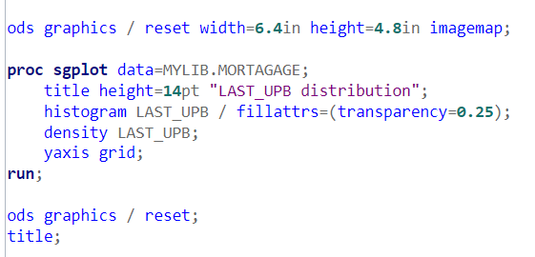
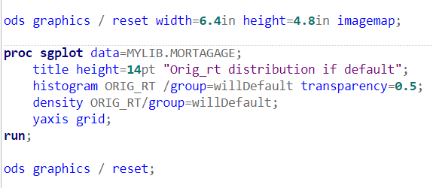
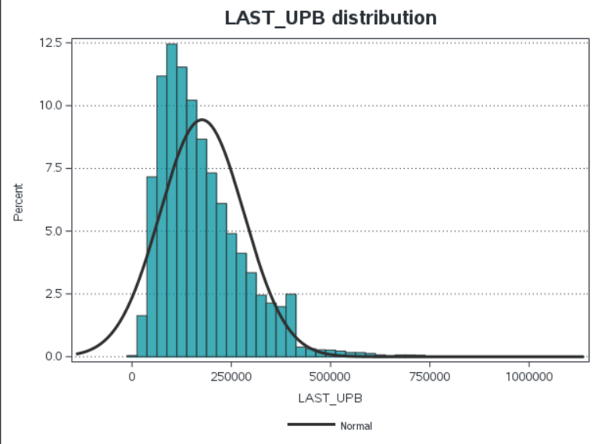
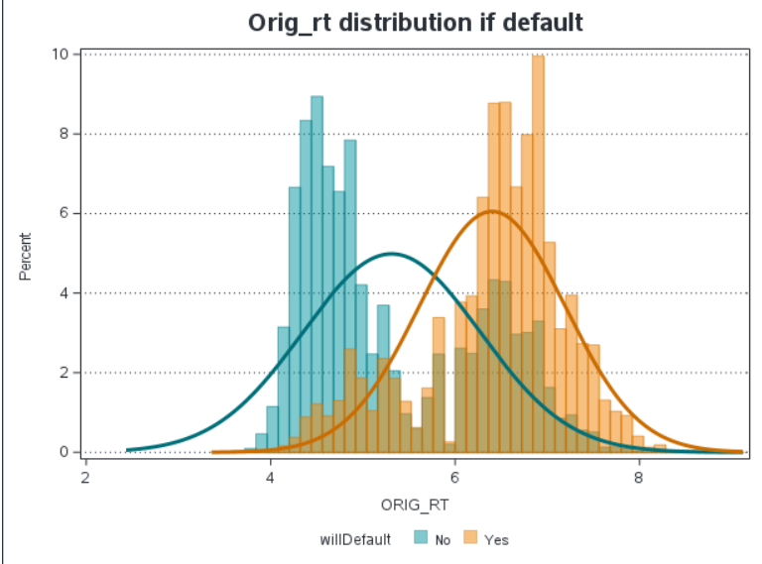
Data visualization
We plotted the distributions for all the variables, splitting also in willdefault=‘yes’ and willdefault=‘no’.
We just reported a couple of examples, and we can see that none of the variable is normally distributed.

Slide 12
Model Studio

Slide 13
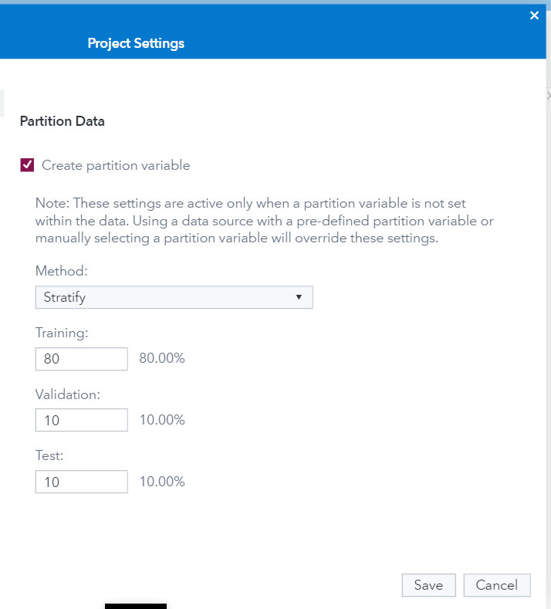
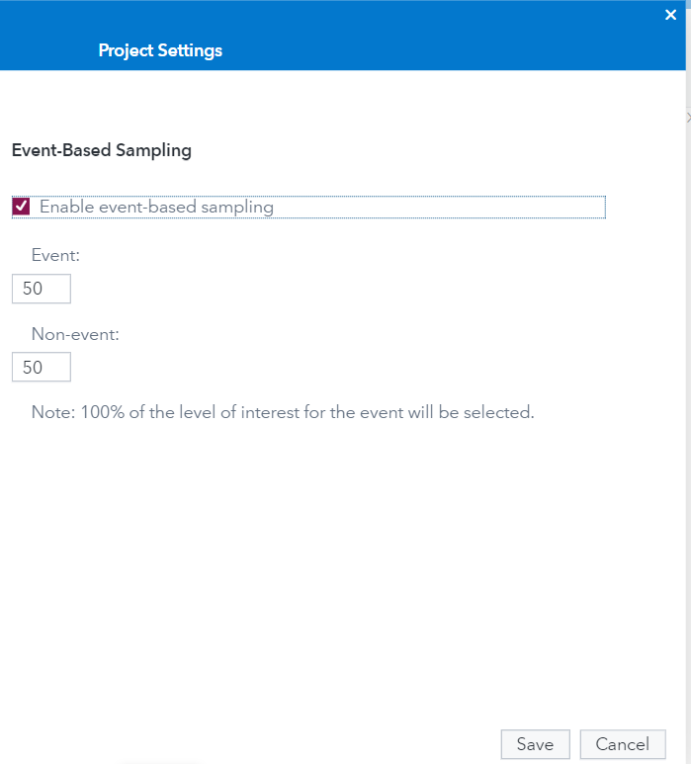
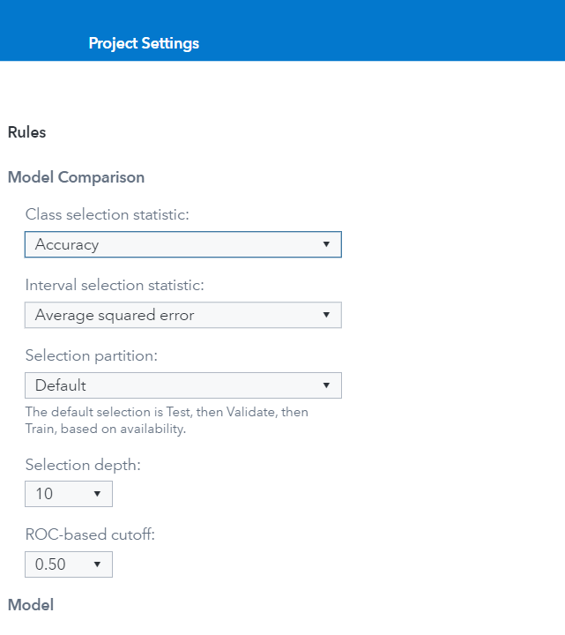
Project Settings
Data Partition:
80% Training
10% validation
10% test
Event-based Sampling:
Unbalanced dataset
50-50 Resempling
Model Comparison:
Prediction accuracy for the loans is the most important thing
Accuracy will be the score measure

Slide 14
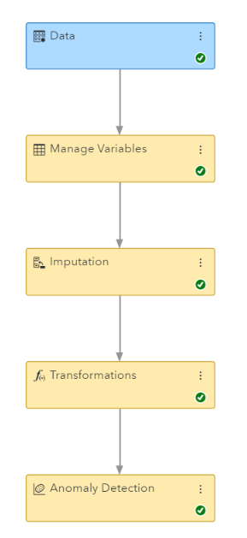
Data preparation
Manage Variables:
Put willdefault as target
Change reject variables into input
Change MI_PCT in interval, since it’s considered as nominal
Imputation:
Inpute missing value to 0 just in the variable MI_PCI
Leave the others variables untouched
Transformations:
Standardize all numeric variables
Anomaly Detection:
Remove eventual outliers

Slide 15
Let’s try some models
In this section we will show a bunch of models that we try in order to find the most accurate one.
About that model we will also discuss about the Results part, while for the others we just concentrate on the accuracy comparison.
Disclaimers:
We are not showing all the combinations we tried, but just the best set of settings for each type of model;
Each of the piplines we are going to show start with the nodes we saw in Data Preparation.

Slide 16
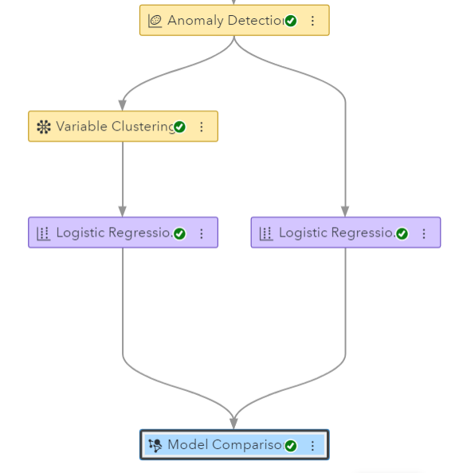
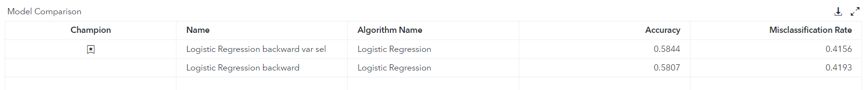
Pipeline1: Logistic regression
We compare 2 logistic regressions with the only difference that one of them had a variable selection using clustering
Variable Clustering:
Number of representative variables: 2
Optimal cluster-selection method: Penalized log-likelihood
Number of clustering steps: 10
All the other settings are the default ones
Logistic regression:
Selection method: backward
All the other settings are the default ones
The logistic regression with the variable clustering is the most accurate.

Slide 17
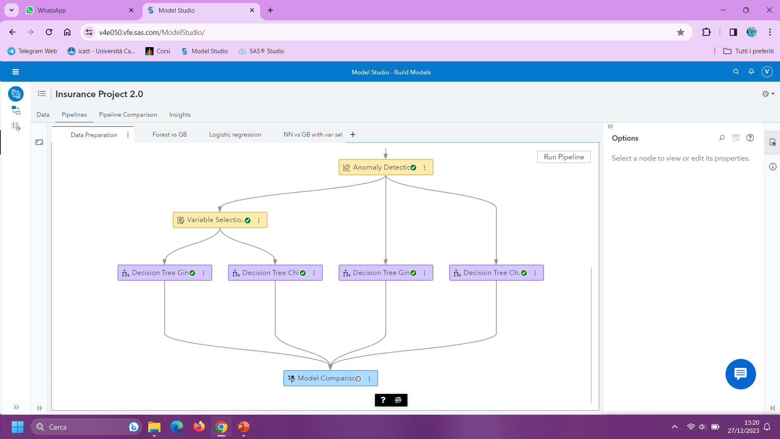
Pipeline2: Decision Trees
Decision_tree_Gini & Decision tree Gini_var_sel :
Splitting options:
Class target criterion: Gini
Number of interval bins: 100
All the other settings are the default ones
Decision_tree_Chi2 & Decision_tree_Chi2_var_sel:
Splitting options:
Class target criterion: Chi squared
Number of interval bins: 100
All the other settings are the default ones

Slide 18
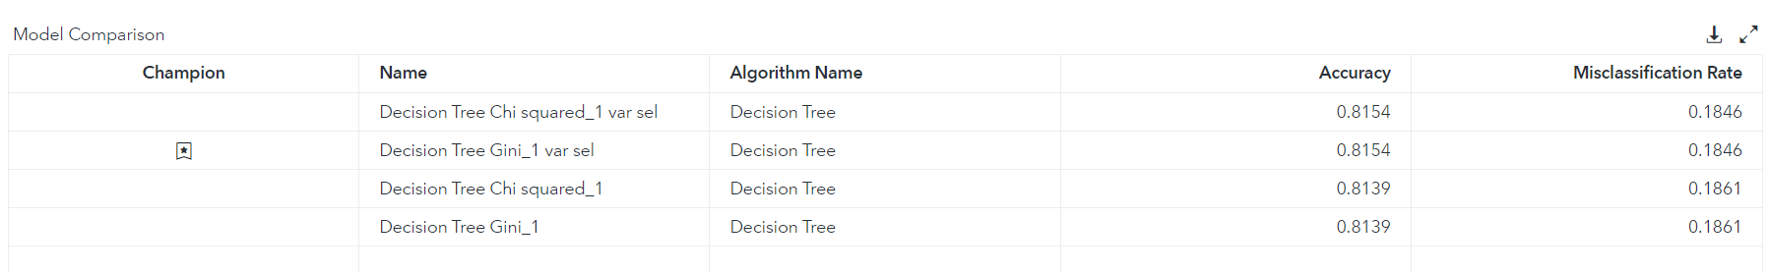
We can see that both Decision_tree_Chi2_var_sel and Decision tree Gini_var_sel reach the same accuracy and misclassification rate. Also looking at the fit statistics we notice that those are exactly the same between the two.
Sas decided to take Decision tree Gini_var_sel as the champion one.

Slide 19
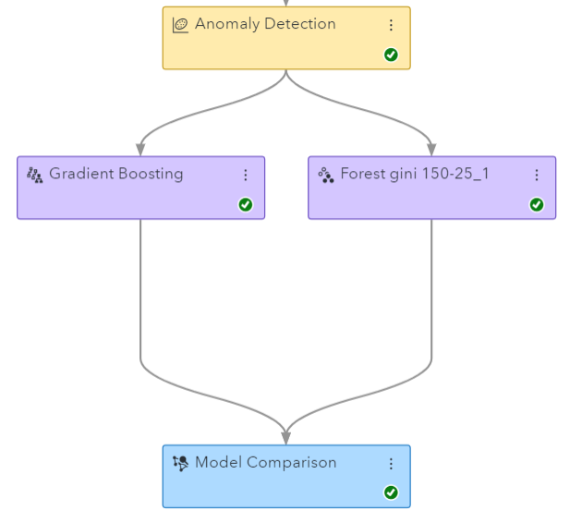
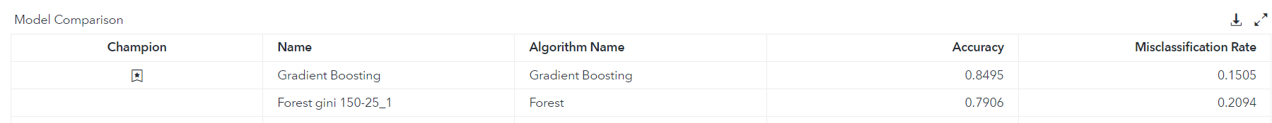
Pipeline3: GB vs Forest
Gradient Boosting:
Basic options:
Number of trees: 200
L1 regularization: 2
L2 regularization: 1
Tree-splitting options:
Maximum depth: 10
Minimum leaf size: 10
Number of interval bins: 100
Forest gini 150-25:
Number of trees: 150
Tree-splitting options:
Class target Criterion: Gini
Maximum depth: 25
Number of interval bins: 100
The Gradient Boosting is the most accurate model between the two.

Slide 20
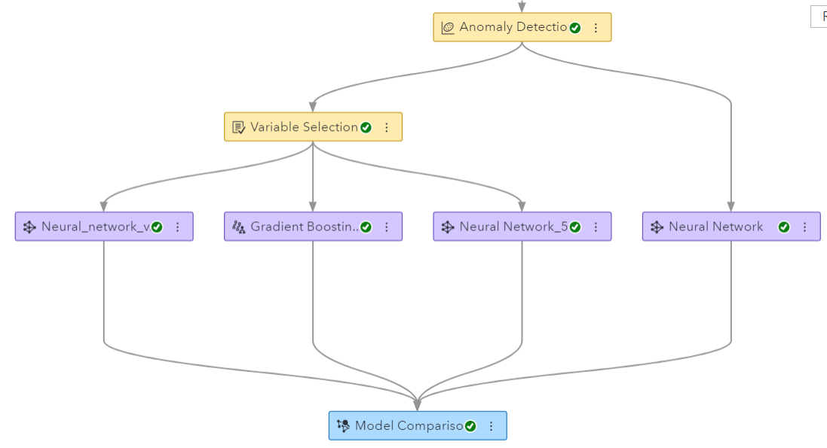
Pipeline4: NN vs GB with variable selection
Gradient Boosting_var_sel:
Basic Options:
Number of trees: 200
L1 regularization: 2
L2 regularization: 0
Tree-splitting options:
Maximum depth: 10
Minimum leaf size: 10
Neural Network_5H_var_sel:
Number of hidden layers: 5
Number of neurons per hidden layer: 100
Activation function: tanh
Neural_network_var_sel & Neural network:
Number of hidden layers: 2
Number of neurons per hidden layer: 100
Activation function: tanh

Slide 21

We can easily notice that the gradient boosting with variable selection is the best model within the four.
Neural networks perform really badly, so probably there is a way to improve them, but we couldn’t find anything better.

Slide 22
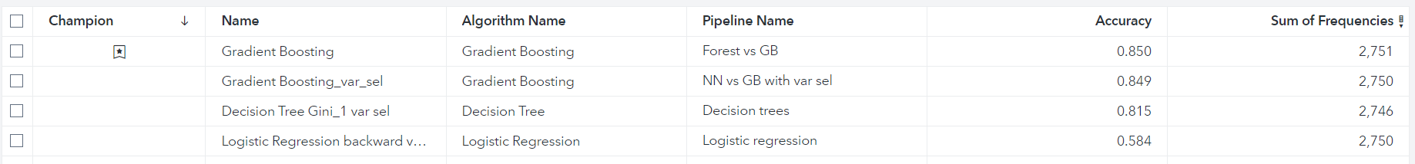
Pipeline Comparison
The Final Pipeline comparison shows that:
The Gradient boosting is the most accurate model we have found (85% accuracy)
The Gradient boosting with variable selection has basically the same performance
Following the Occam Razor’s principle we choose the Gradient Boosting with variable selection as the best model because:
Mantain the higest accuracy
Uses a simpler reduced dataset

Slide 23
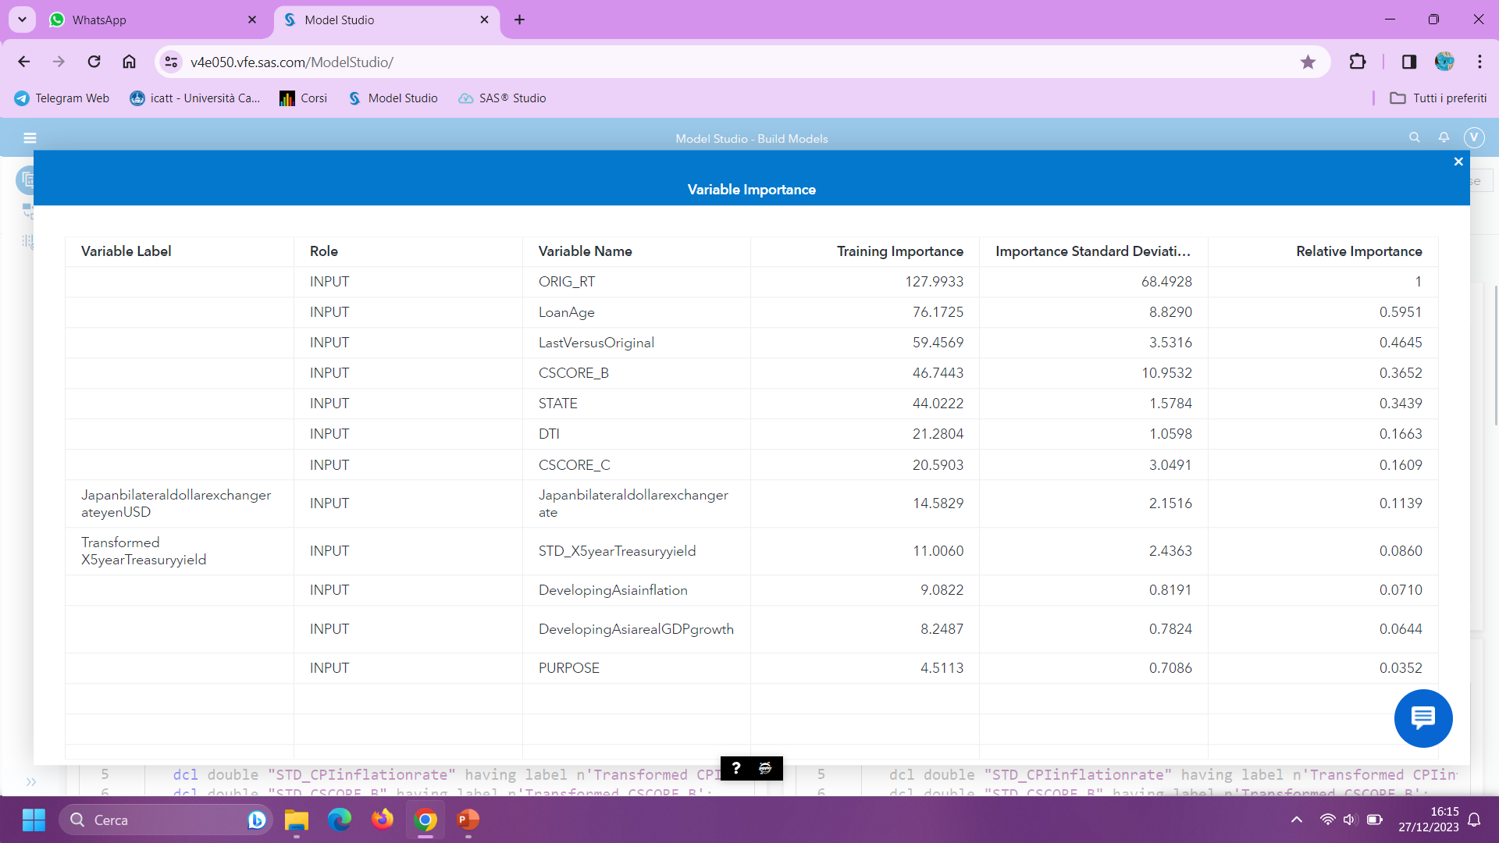
Model Results
Most important Loan default predictors are:
ORIG_RT that could stand for the “original interest rate” of the loan, meaning the loan risk
Loan age
LastVersusOriginal that could stand for the interest rate variation
Credit score
State

Slide 24
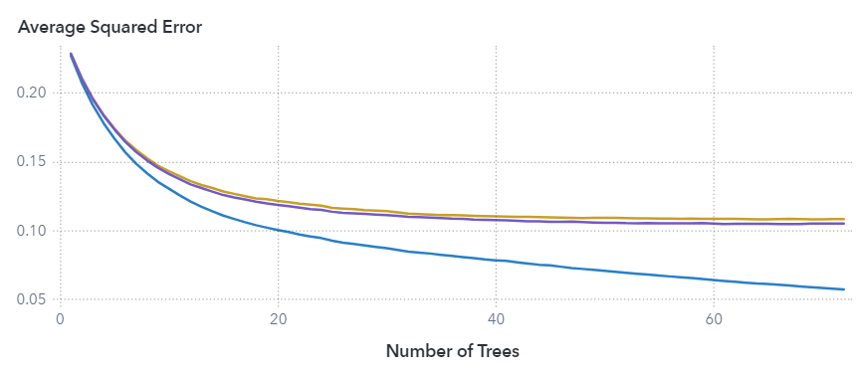
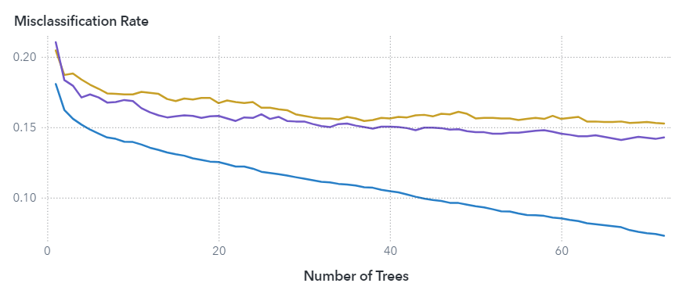
Looking at the Average squared error:
It decreases as the number of trees increases
But the improvement gets weaker and weaker
So we could have stopped even at 50 trees where the improvement is not worth the computational expense of getting more trees
Looking at the misclassification rate
It decreases
But remain pretty stable in valdiation/test

Slide 25
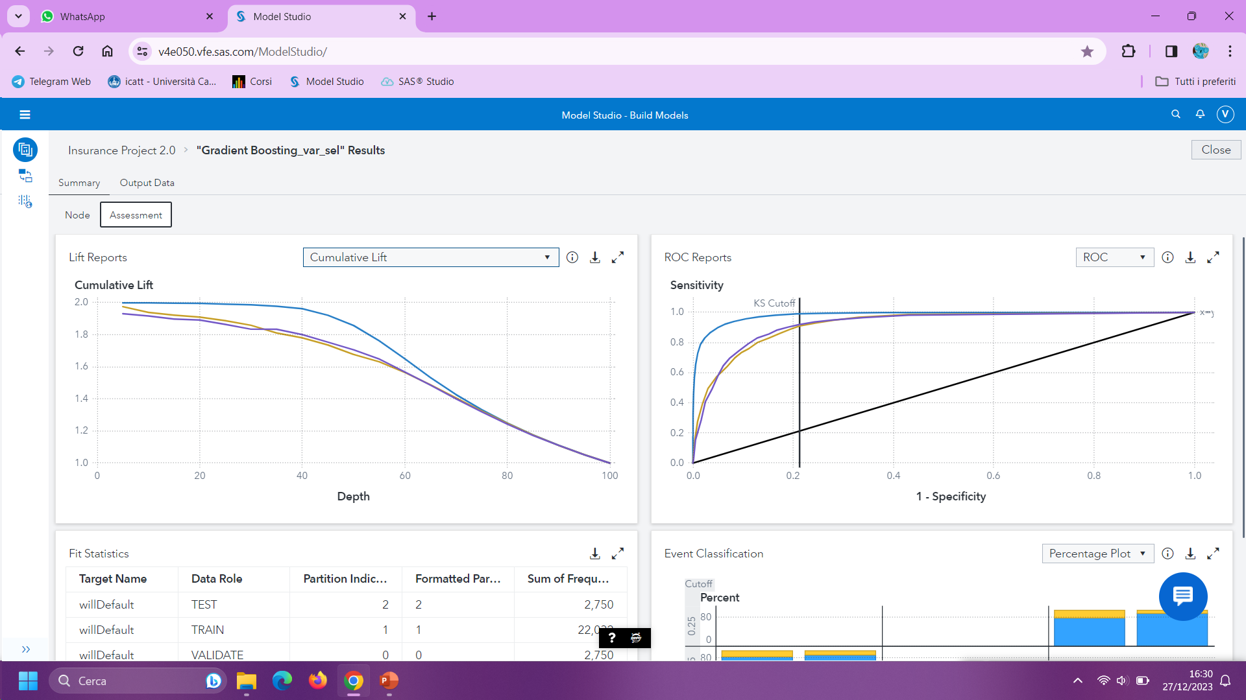
Lift curve:
Is the ratio between the result predicted by our model and the result using a random model.
Show that it’s better to use our predictive model.
ROC curve
wide area that show a good accuracy in our model

Slide 26
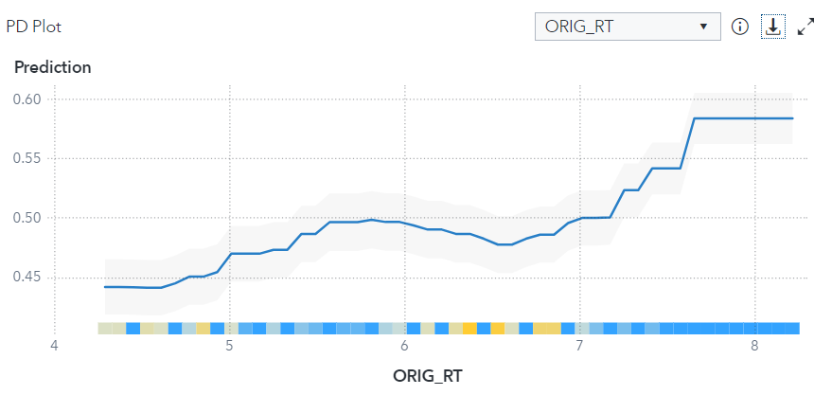
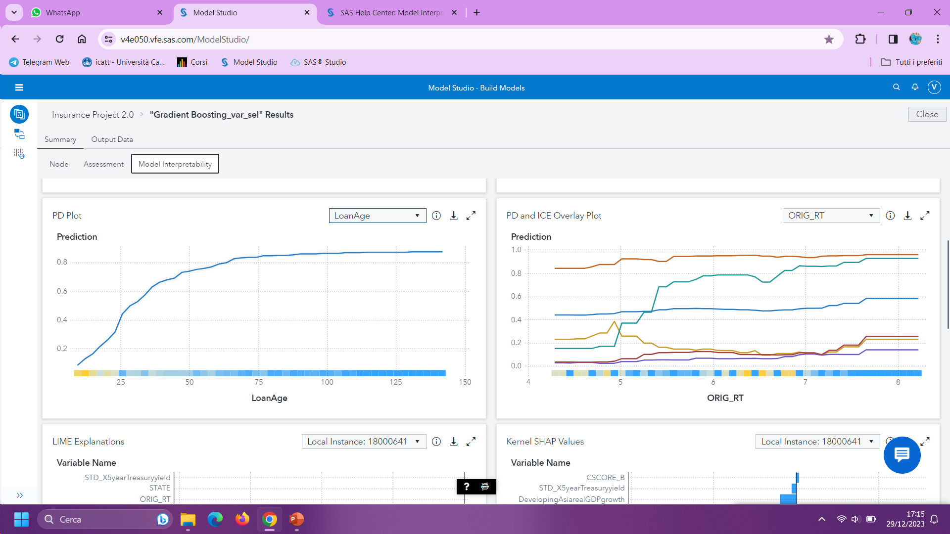
Model global interpretability
PD PLOT:
ORIG_RT importance
LoanAge decreases prediction influence as it gets bigger
ICE PLOT:
Since the curves do not follow the PD one, we can understand that also other variables are important in the prediction.

Slide 27
Thank you!

